Slide 1
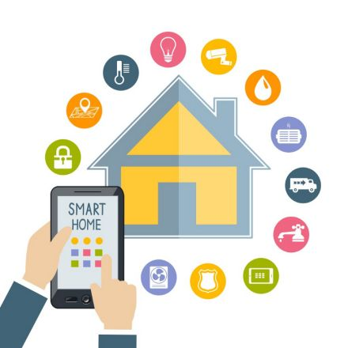

IoT Smart Home Systems
SWENG 837
Fall 2024
Juan Arellano

Slide 2
Introduction
IoT Smart Home System
This smart home system aims to solve the issues that exist in the smart home ecosystem.
This new system allows users to set up their smart devices in an easy and fun way.
The process to set up a device will be less than one minute allowing users to set light bulbs, thermostats, smart vacuum, TVs and other devices in a very short amount of time with minimum effort.
It is recommended that the devices are set up by users who are 18 and older.
Users will be able to easily set up personalized schedules by user on the app or website.

Slide 3
Business Requirements
User Experience
Easy to setup
User friendly interface on smart phone, tablet, and wearable devices.
Bluetooth and WIFI device detection at device set up.
Smart speakers with several microphones for easy user hearing.

Slide 4
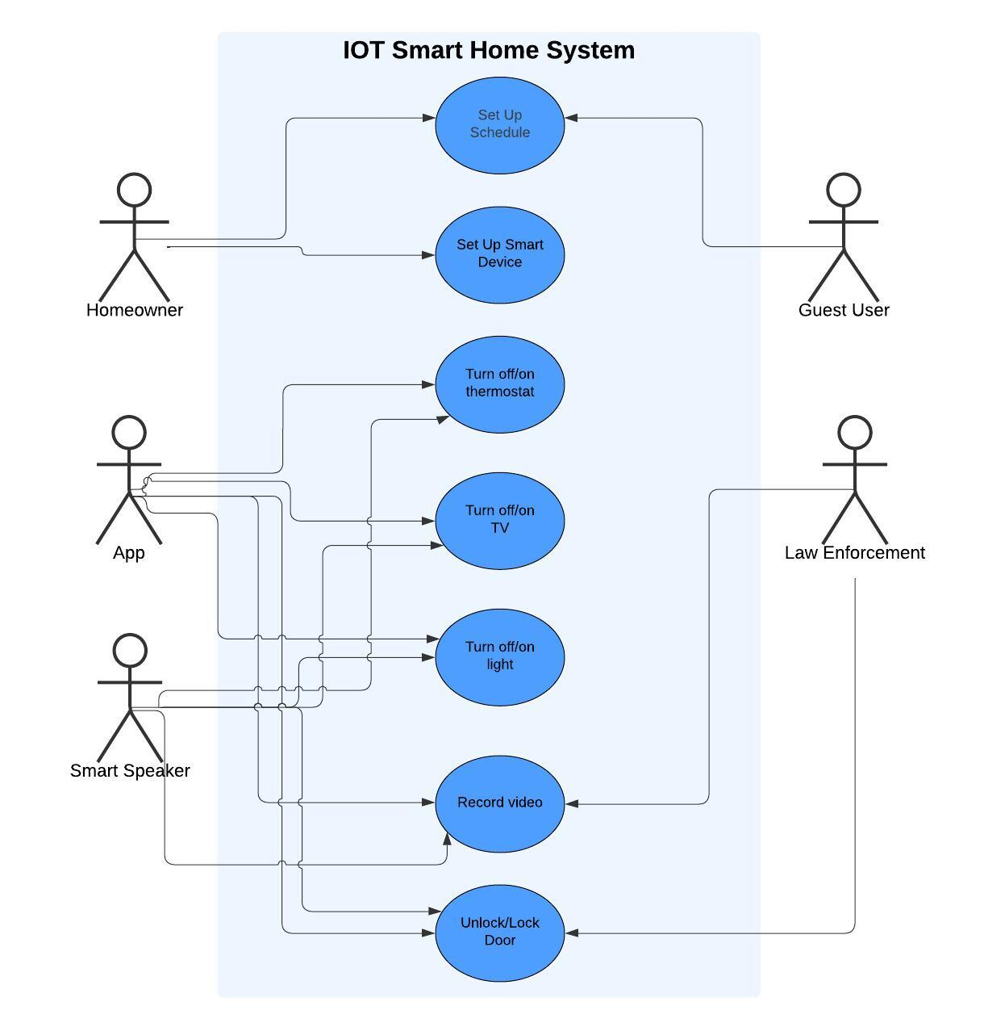
Use Case Diagram

Slide 5
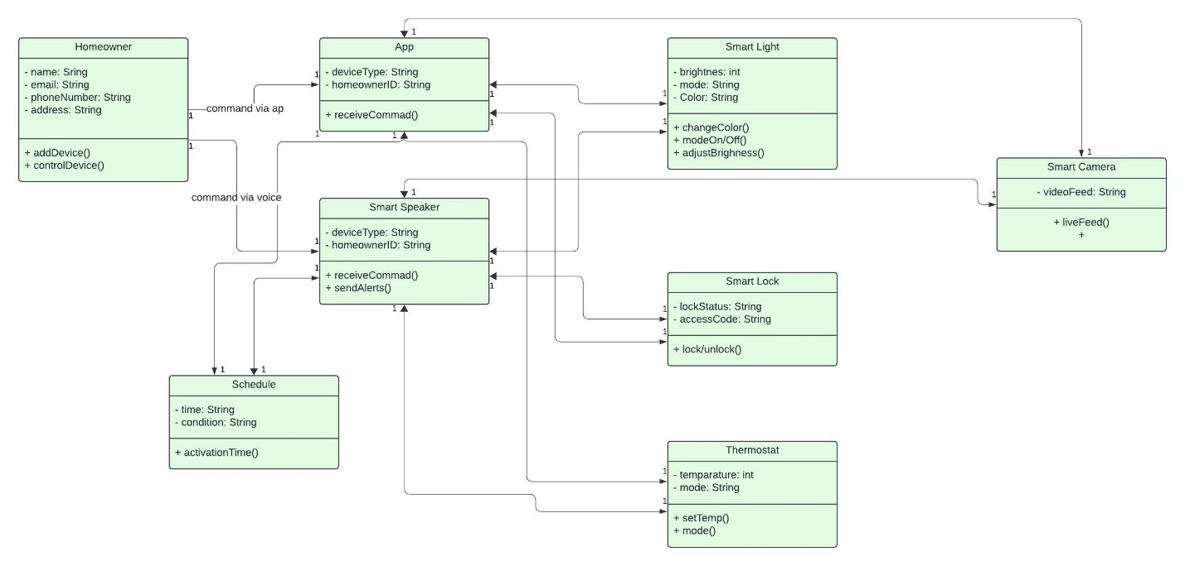
Class Diagram

Slide 6
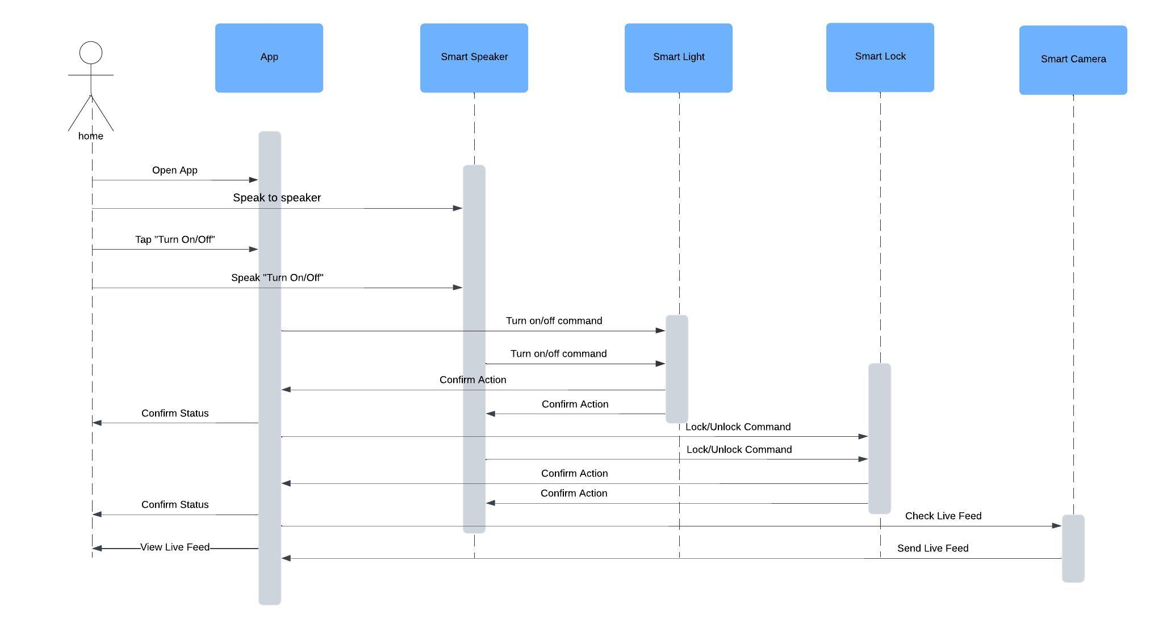
Sequence Diagram

Slide 7
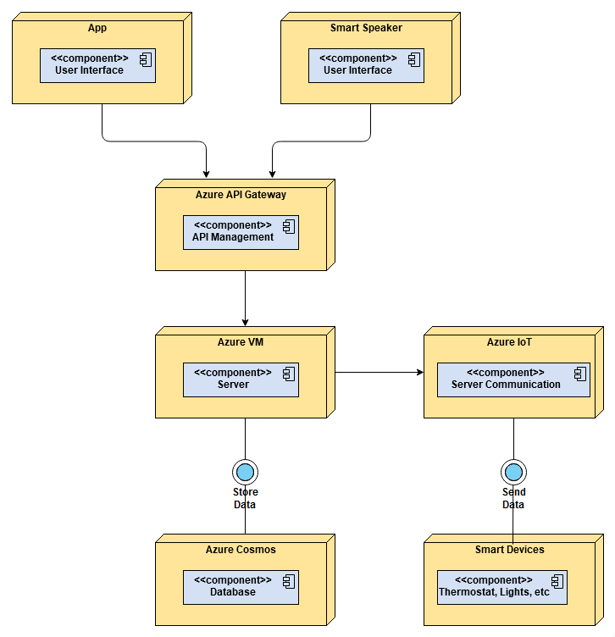
Deployment Diagram

Slide 8
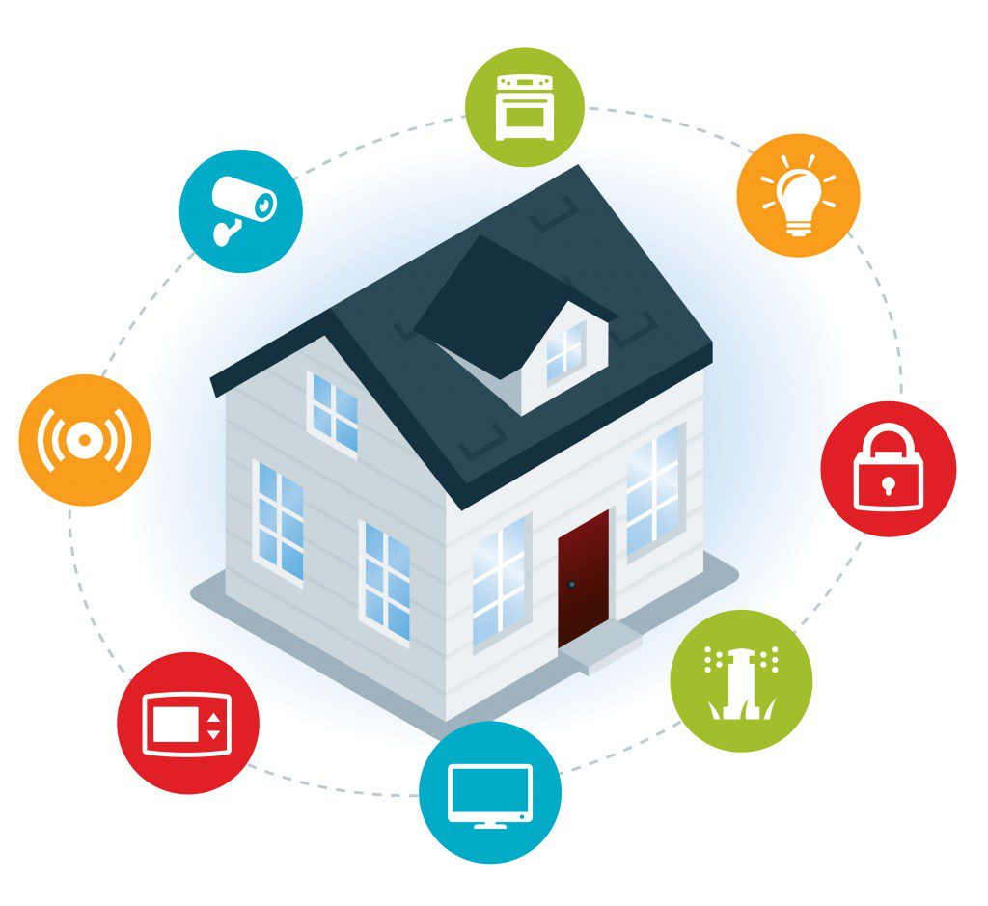
Thanks !

